Slide 1
Malahide Safe Routes to School
Malahide Community Forum
June 2021

Slide 2
Key Routes
Seabury - Pope JPII Primary School
Pedestrian and cycle bridge over railway, at rear of Malahide Community School
Robswall / Seapark / Abbots Hill - Seamount Road - Malahide Community School and relocated Portmarnock / Malahide Educate Together Primary School

Slide 3
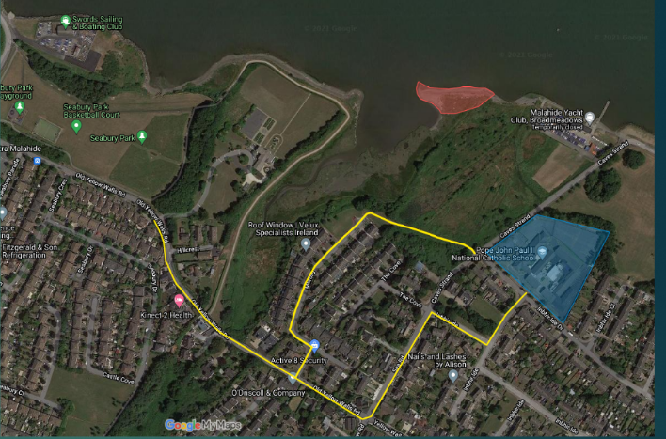
Seabury to Pope JPII School, present routes via Old Yellow Walls Rd & Barrack Bridge

Slide 4
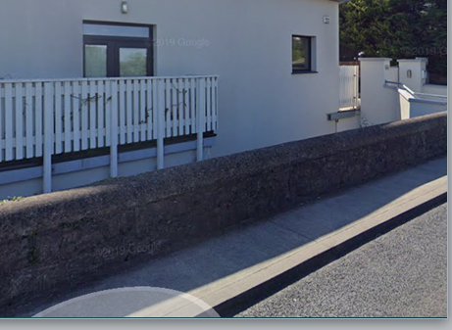
Sub-standard footpath on one side of Old Yellow Walls Rd, no footpath on other side

Slide 5
2020 Survey of 465 Local Residents
92% who had children walking to school via Old Yellow Walls Rd / Barrack Bridge felt it was unsafe
Only 6% of respondents used cycling as their main mode of travel
Residents want FCC to come up with a solution which will allow children to walk or cycle to school safely

Slide 6
One-way traffic on Old Yellow Walls Rd. would allow footpath to be widened
FCC’s Operations Dept. have stated they have no plans to alter the present two-way vehicular system along Old Yellow Walls Rd
Proposal opposed by residents, because of its adverse impact on access to bus services

Slide 7
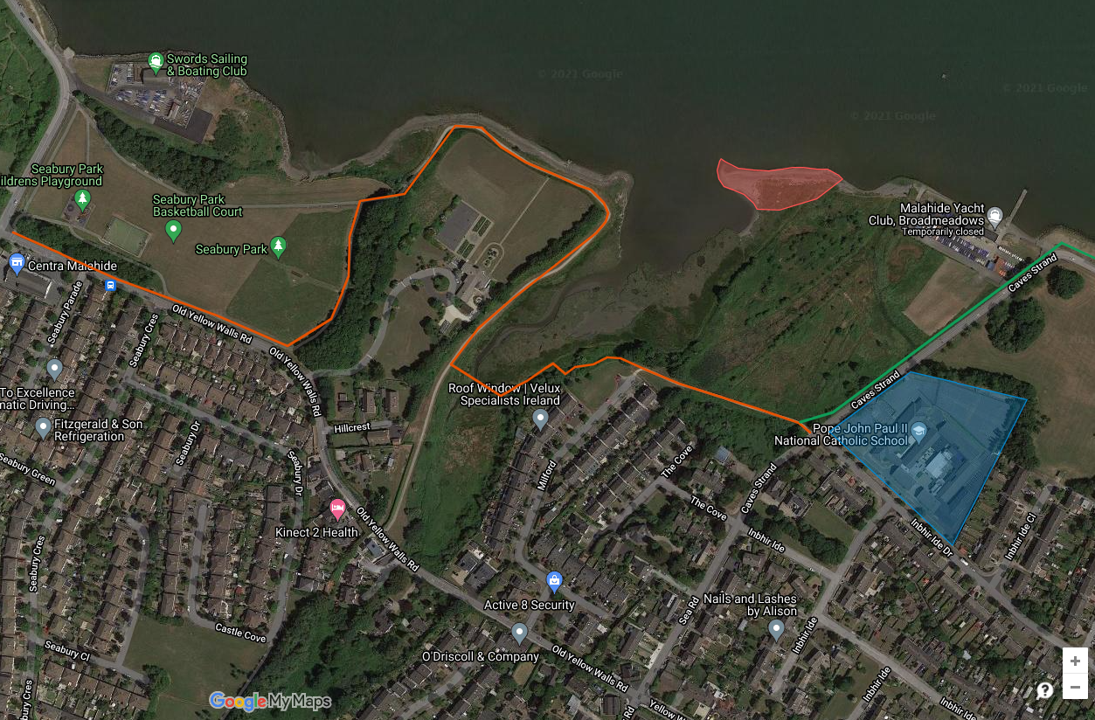
Solution proposed by FCC in 2006

Slide 8
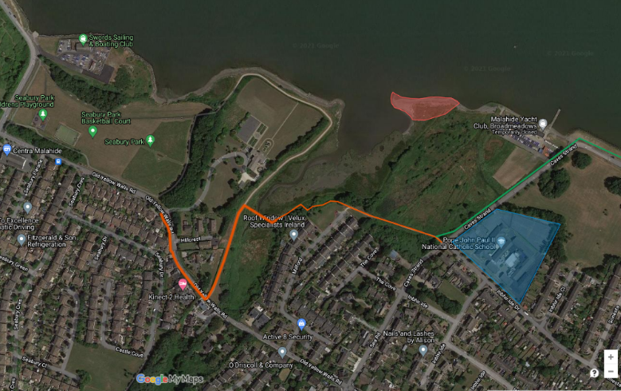
Parents believed children would instead take the short cut indicated below

Slide 9
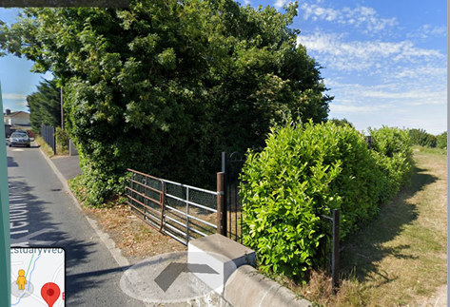
Rejected by residents as unsafe, as children would have to cross road from blind exit

Slide 10
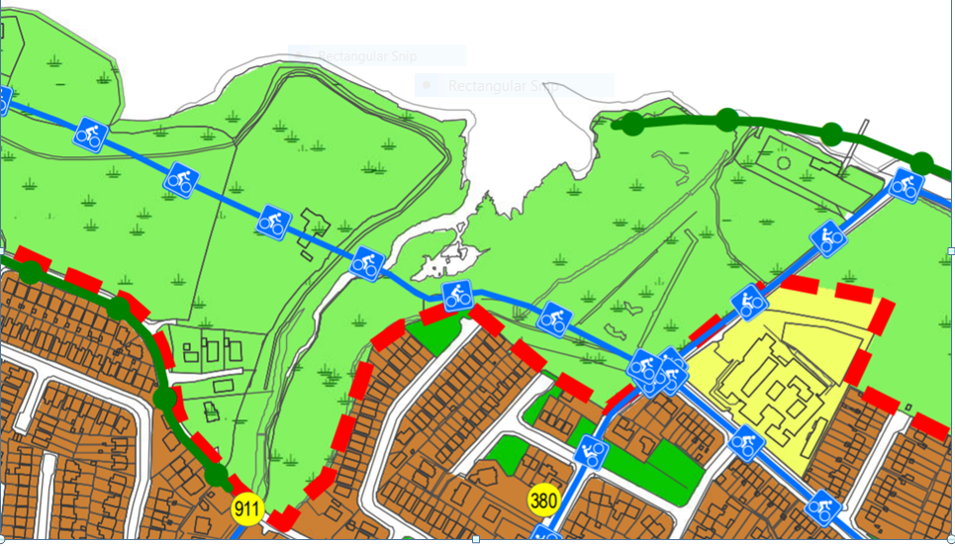
2017-2023 County Development Plan
Proposed Swords-Malahide cycleway

Slide 11
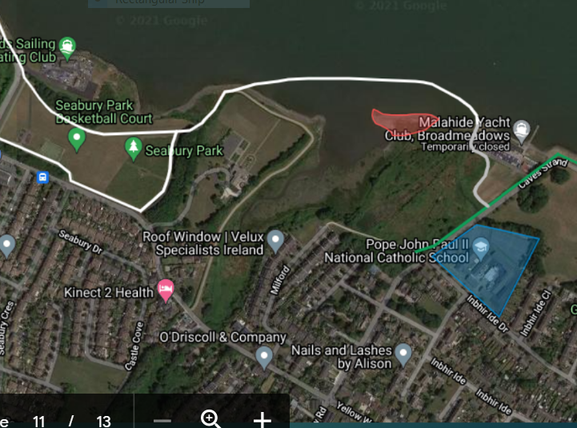
Alternative, floating boardwalk excellent for Swords-Malahide, but a long way to school

Slide 12
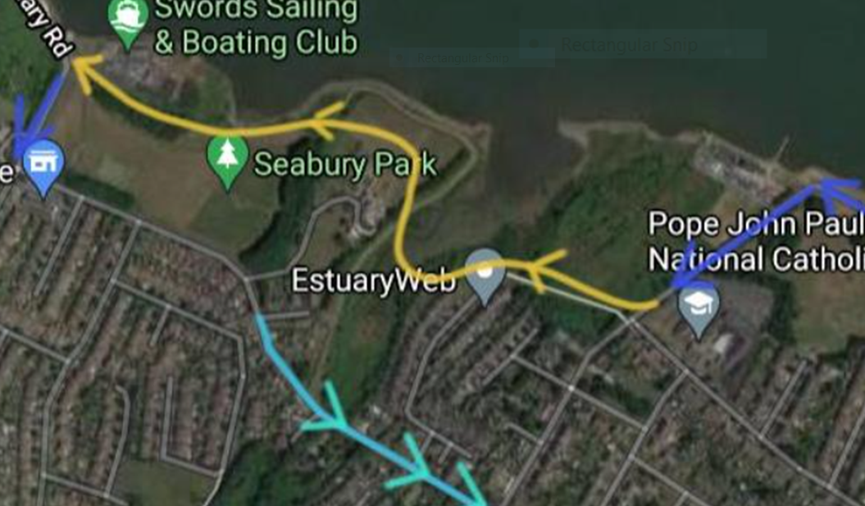
2023-2029 Development Plan:
Road proposal by owner of Estuary House

Slide 13
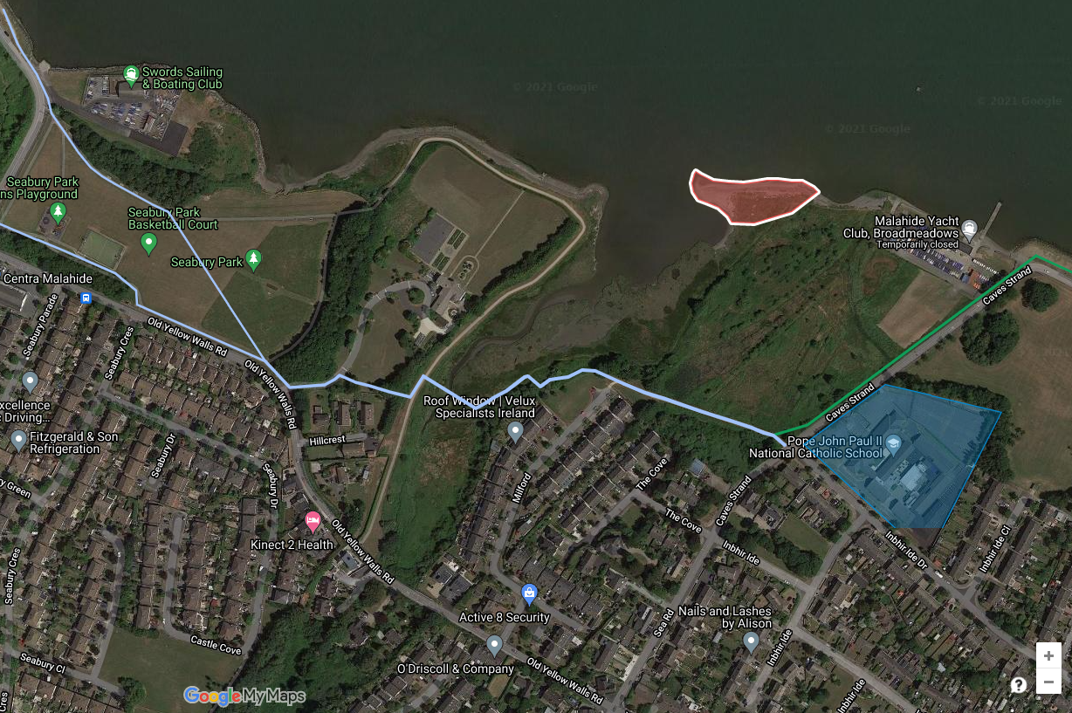
Potential route for Swords-Malahide cycleway and a short route to school

Slide 14
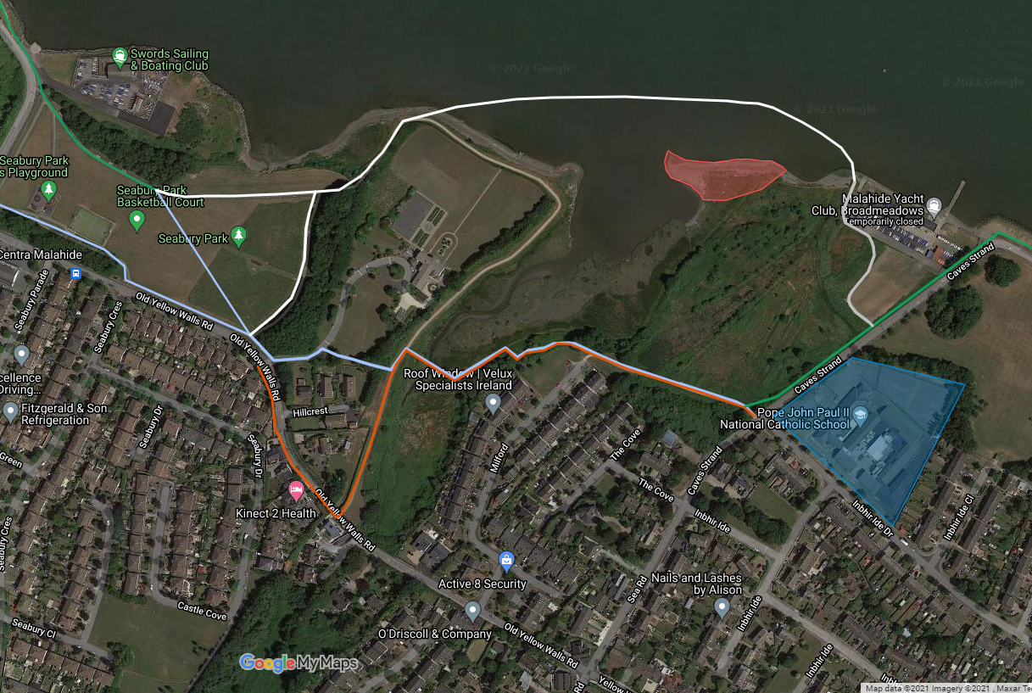
Comparison of alternatives

Slide 15
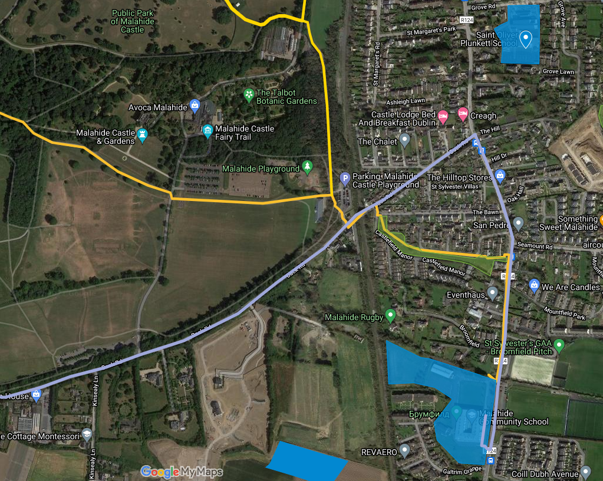
Malahide West: current routes to
Malahide Community School

Slide 16
Malahide Community School has 1250 pupils
60% live west of the rail line
This proportion will increase as new housing is built on the Back Rd. Kinsealey Lane and Chapel Lane
All use the R124 to get to school. It is a narrow substandard road, with a narrow footpath on one side and none on the other side
It is also used by primary school children going in the opposite direction to St Oliver Plunkett’s and St Andrew’s Schools
The result is a fatal accident waiting to happen

Slide 17
Solution
Construct a pedestrian / cycle bridge over the rail line at the rear of MCS, to the old Rugby Ground site, at an estimated cost of €1.1m
This would provide safe pedestrian and cycle access to both MCS and the relocated Portmarnock / Malahide Educate Together Primary School
Proposal presented to MCS’s BoM and the Principal has written to MCS Patrons seeking approval

Slide 18
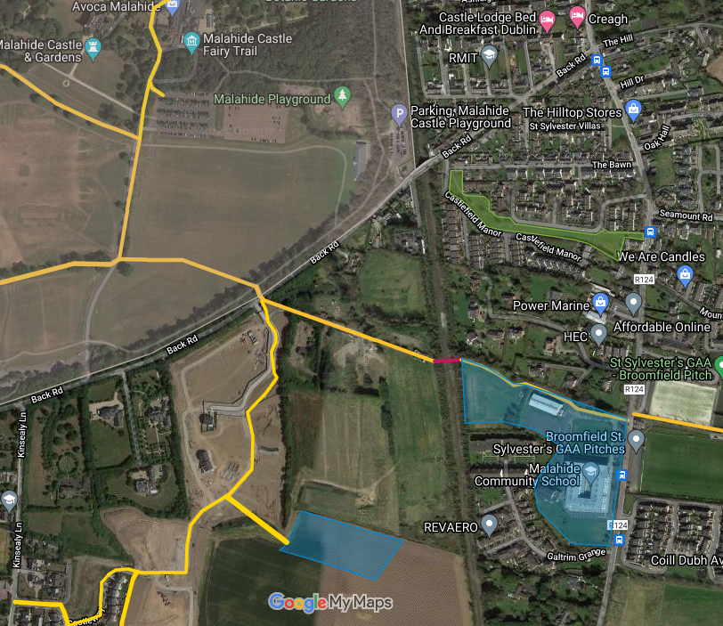
Proposed pedestrian / cycle routes to
MCS and P/M ET PS
Back road Carpark
Proposed site for new Malahide / Portmarnock Educate Together primary school

Slide 19
Key Requirements
That a new pedestrian / cycle entrance to Malahide Demesne be provided at the existing signalised pedestrian crossing on the Back Rd.
That the roads in the Ashwood Hall and in the old Rugby Club area be treated as “School Streets”
That the existing car park at the main Back Rd. entrance to Malahide Demesne be designated as the vehicular drop off point for both MCS and P/M ET PS

Slide 20
Conclusions
These proposals are
Novel
Technically and environmentally feasible
Very cost effective vs roadworks solutions
Wholly consistent with Government policies
Consequently eminently fundable
They also indicate that the P/M ET PS would be better located on the old Rugby Club pavilion site

Slide 21
Our Ask
That these proposals be
Incorporated into FCC’s 2023 – 2029 Development Plan
Incorporated into the planning process for the old Rugby Club lands and made a condition for the development of these lands.
Be executed as quickly as possible

